Slide 1
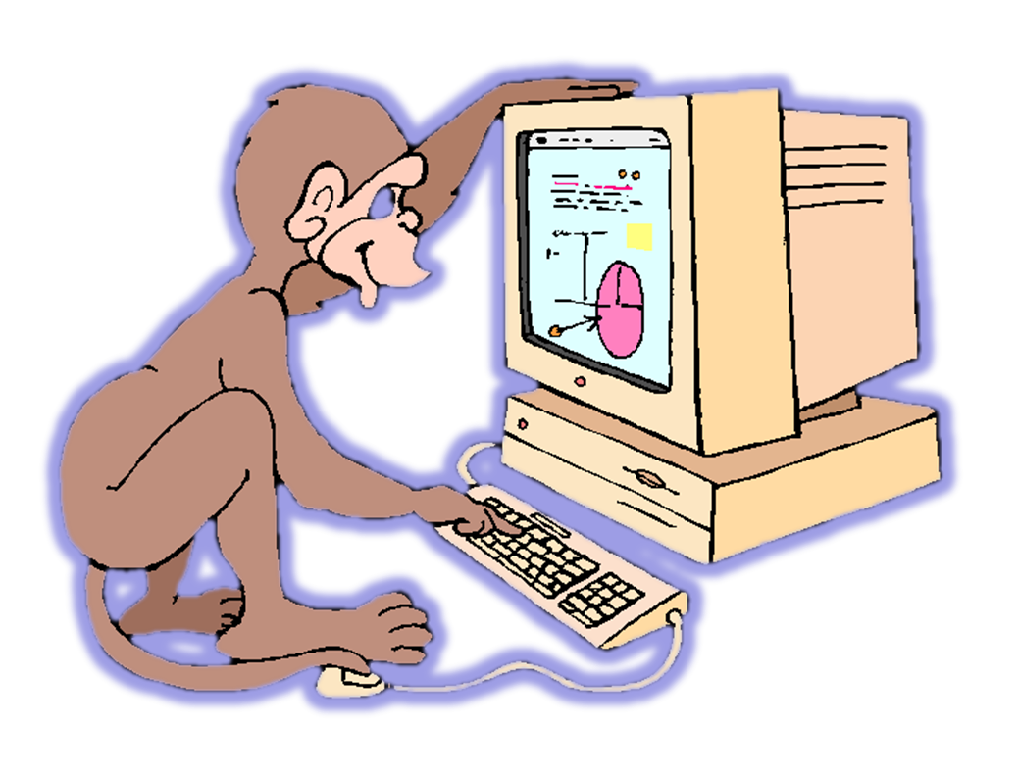
Specification Demo
EKE 749 Group Assignment 2
Team 6, Code Monkeys.
Notes:
6조의 specification demo 발표를 맡은 이대홍입니다.
저희 조의 이름이 code monkeys이기 때문에 monkey그림을 올렸습니다.

Slide 2
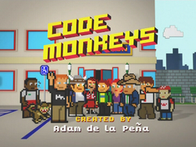

Code Monkeys
Notes:
First, I explain about ‘Code Monkeys’.
‘Code Monkeys’ has two means.
First is an American animated television program in the early 1980s.
Second, A Code monkey is a computer programmer or other person who writes computer code for a living.
This term may be slightly derogatory, meaning that this developer can write some code but is unable to perform the more complex tasks of software architecture, analysis, and design^{[1}
In other words, code monkey means not efficient person.
But, we use this name paradoxically.

Slide 3
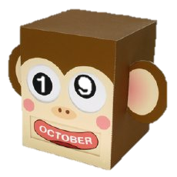
Introduce
Group name : Code Monkeys
Project name : Monkey Calendar
Notes:
So, our group name is ‘Code Monkeys’.
And our project name is also about monkey.
This monkey seems very cute. Isn’t it?
So, our project name is ‘Monkey Calendar’.

Slide 4
Contents
Objective
Features
Environment
Notes:
First, I introduce objective of this project.
And second, I introduce monkey calendar’s features.
This is consist of basic requirements and additional features.
And last, I explain our task environment.

Slide 5
Objective
Write a calendar and appointment scheduler system.
    Construct features, interface, limitation, etc..
    Add GUI, instead of just text
Notes:
This project’s object is writing a calendar and appointment scheduler system.
This system is Constructed by features, interface, limitation, etc…
Especially, we use windowing interface to emphasize visual impressions.
I will explain this parts in the back.

Slide 6
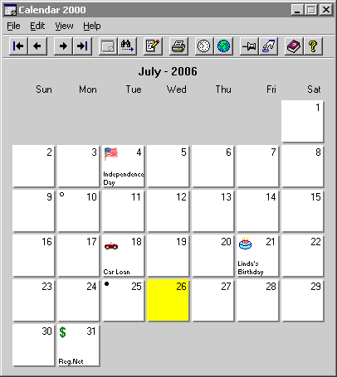
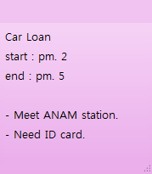
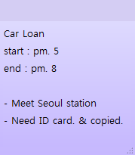
Basic
Printing and Changing appointments
Notes:
We use graphic user interface which is called GUI.
So, I explain Monkey Calendar’s features using animations and pictures.
First, I treat very fundamental calendar’s features.
The picture of this calendar is used just explain.
So our interface will be changed later.
In this picture, calendar prints year, month, day, and date.
It is very basic function of calendar.
If user want record about appointment, click and write that like this.
Like I said, this picture will be changed.
We scheduled to represent this by using text.
Return to this calendar, sure, it is possible to
change appointment or
Clear appointment.

Slide 7

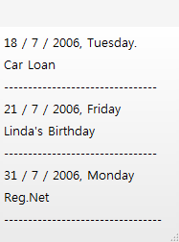
Basic
Listing and Save & Load system
Load
Appointment1.MC
Save
Notes:
Next, if user sets appointments like this,
User can print all appointments for a given year, month, week, or day.
It’s good for seeing all appointments easily.
And we can save & load the set of all appointments to a file like this.
By using save & load system, user can treat various schedule separately.

Slide 8

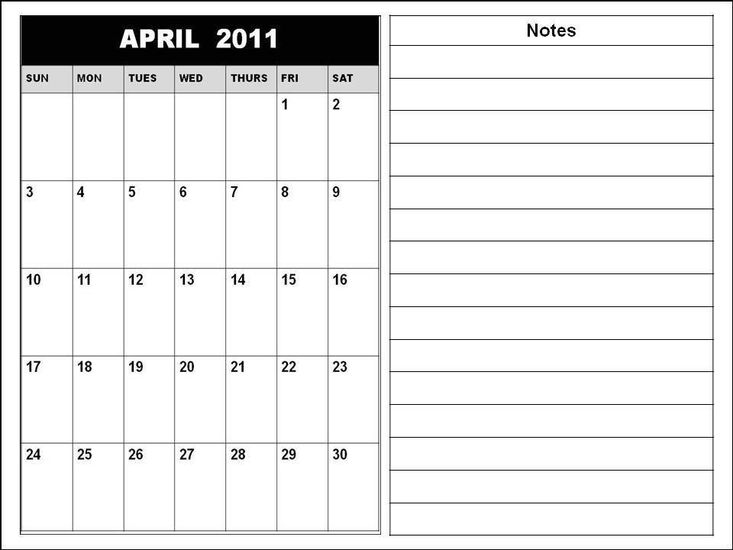
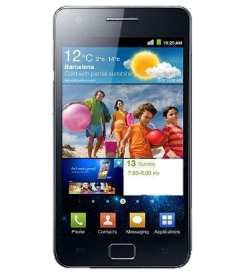
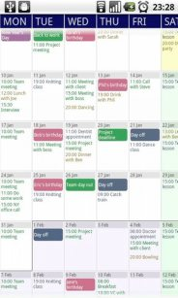
Interface
GUI(graphic user interface) using
android graphic library
Notes:
To use GUI interface, we must select how to show this.
So, we decide to use android operating system.
We may using eclipse and we will test virtual machine and smart phone.
Sure, this calendar image is just come from googling. Not ‘Monkey Calendar’.
‘Monkey Calendar’ is maybe better than this one!!

Slide 9
Fields
Adding additional fields
FEBRUARY
Name
Car Loan
Day
2 / 4 / 2011
Start
Pm. 5
End
Pm. 8
Location
Seoul station
People
Car manager
Need ID card & copied
Description
Notes:
From this slide, I explain about additional function of Monkey Calendar.
When we click that date, we can see detailed information.
General calendar application is consist of name, day, and time like this.
Monkey calendar provides additional fields like location, people.
So user can classifies information easily and sees calendar at a glance.

Slide 10
Repeating
Repeating appointments easily
FEBRUARY
Name
Volunteer Work
Day
2 / 9 / 2011
Start
MARCH
Pm. 2
End
Pm. 7
Location
Korea univ.
People
Colleague
Sometimes location will be changed.
Memo
Notes:
When we set appointment, we sometimes set appointment repeatedly
Monkey Calendar can repeat appointments just click.
We will make checkbox to select repeating or not.
Through this menu, user can repeats appointments every weeks like this.
Or every month.
It is useful setting appointments like card payment or weekend business report.

Slide 11
Spanning
Setting appointment periodically.
FEBRUARY
Name
Team meeting
Day
2 / 4 / 2011
2 / 4 ~ 2 / 8
Start
Pm. 5
End
Pm. 8
Location
Room. 312
People
Description
Notes:
Monkey calendar is also good for not one day appointment but also multiple days appointment.
For example, If user assign appointment from Feb 4 to Feb 8, user easily sets this appointment by using drag from 4 to 8.
This is useful setting appointment like homework date, vacation season, and so on.

Slide 12
Notification
Reporting overlapped appointment.
FEBRUARY
Name
Volunteer Work
Name
Team meeting
Day
2 / 4 / 2011
Day
2 / 4 / 2011
Start
Pm. 2
Start
Pm. 5
End
Pm. 7
End
Pm. 8
Location
Korea univ.
Location
Room. 312
People
Colleague
People
Is it OK?
Sometimes location will be changed.
Description
Description
Notes:
When we make an appointment, we sometimes make a mistake about appointment date or time.
Monkey calendar reports if two appointments are at the same time.
For example, User sets appointment Feb 4.
But if user writes to set another appointment which is overlapped before appointment,
System shows message about this.
If user doesn’t care about it, just passes this message.
And if user wants to set overlapped appointment, just clicks OK.

Slide 13
Special day
Holiday & Lunar calendar
MAY
Lunar Calendar
4 / 4 / 2011
Children’s day
Lunar Calendar
4 / 8 / 2011
Buddha's Birthday
Lunar Calendar
4 / 18 / 2011
Notes:
Next, It show holiday & lunar calendar.
For example, this calendar show MAY.
We can see children’s day and buddha’s birthday easily.
And if you want,
You can see Lunar calendar.
We usually use solar calendar.
But sometimes we need lunar calendar.
This function is good for that time.

Slide 14
Tasknote
Adding stationary tasknote
MARCH
July
Keep household accounts
Write self-introduction
Repair notebook
Notes:
Next, Monkey calendar has additional tasknote.
Sometimes we have a important information.
By using this tasknote, user can treat important things easily.
Because, although moth is changed, tasknote is keeped.
Additionally, tasknote always keep staying under the calendar like this.
So, user can always see this part.

Slide 15
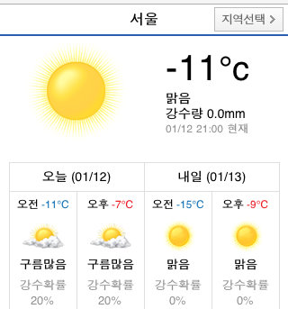
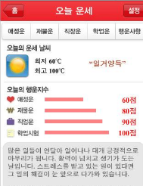
Day information
Providing various information day-by-day
Biorhythm
Weather
Myfortune
Link
Notes:
Every day, Monkey calendar provides funny information.
This application provides three information every day.
User can see three menu, Biorhythm, weather, and my fortune.
If user clicks weather,
Application shows that day’s weather through link.
And if user clicks Myfortune
User also can see his fortune.
Through this simple link, this application play a role as a interest.

Slide 16
Localization
Localization to current region(optional)
FEBRUARY
MARCH
Volunteer Work
Name
Volunteer Work
Name
Day
3 / 9 / 2011
Day
2 / 9 / 2011
Start
Pm.. 2
Start
Pm. 2
Pm. 7
End
Pm. 7
End
Location
Korea univ.
Location
Korea univ.
People
Colleague
People
Colleague
Sometimes location will be changed.
Sometimes location will be changed.
Description
Memo
Notes:
From this slide, I introduce optional features.
Because i cannot sure providing this function,
So i separate this slide.
Through this localization, user can select language.
If user select Korean, almost name of menu will be changed like this.
This application will provide Korean and English.

Slide 17
Localization
Localization to current region(optional)
FEBRUARY
내용
3월
Volunteer Work
제목
Volunteer Work
Name
일
월
화
수
목
금
토
날짜
3 / 9 / 2011
Day
2 / 9 / 2011
시작시간
Pm. 2
Start
Pm. 2
Pm. 7
끝 시간
Pm. 7
End
장소
Korea univ.
Location
Korea univ.
사람
Colleague
People
Colleague
Sometimes location will be changed.
Sometimes location will be changed.
추가 설명
Memo

Slide 18
Environment
Android version : 2.1
Resolution : 800 x 480 WVGA
Input device : touch, virtual keyboard
Notes:
Our application will be developed on Android 2.1.
2.1 a.k.a. Éclair is most popular version of android.
And except one person we have Android 2.1 phones in our team.
To test our application we will test our own phones. But all of them has Éclair version.
And this resolution is widely used in these days.
Definitely the phones support touch screen. So User Interface will be based on touch screen input device.

Slide 19
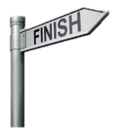
Ask me anything!

